Slide 1
Enabling Distributed Configuration & Control for WiFiMon Probes
Elisantila Gaci, RASH
WiFiMon Service Owner
RIPE 86, Rotterdam, Netherlands
23 May 2023
www.geant.org

Slide 2

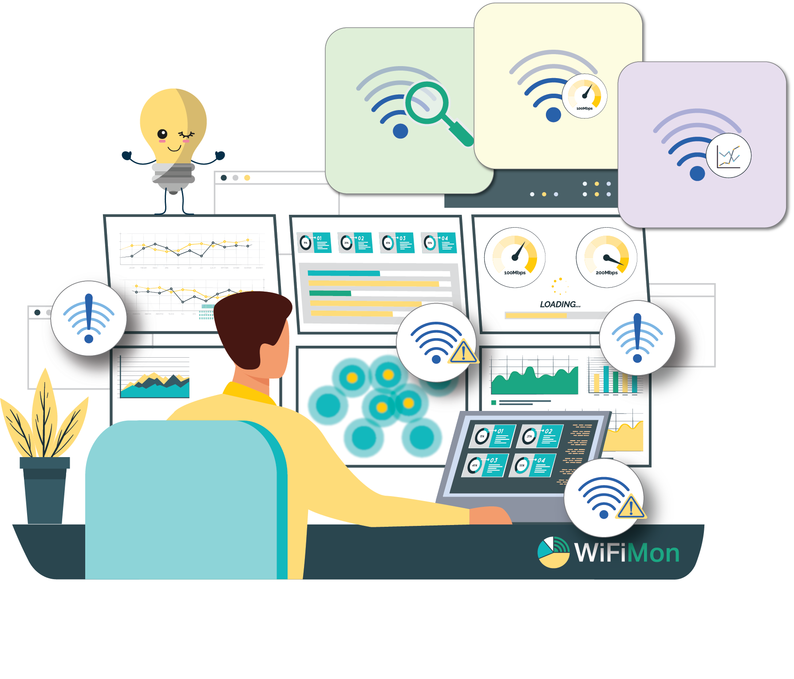
WiFiMon: Introduction
An open-source wifi network monitoring and performance verification system
Vendor - independent,
Transparent to the WiFi network users
Uses well-known open-source components
Independent of WiFi network technology
Captures user’s perception of the network quality

Slide 3
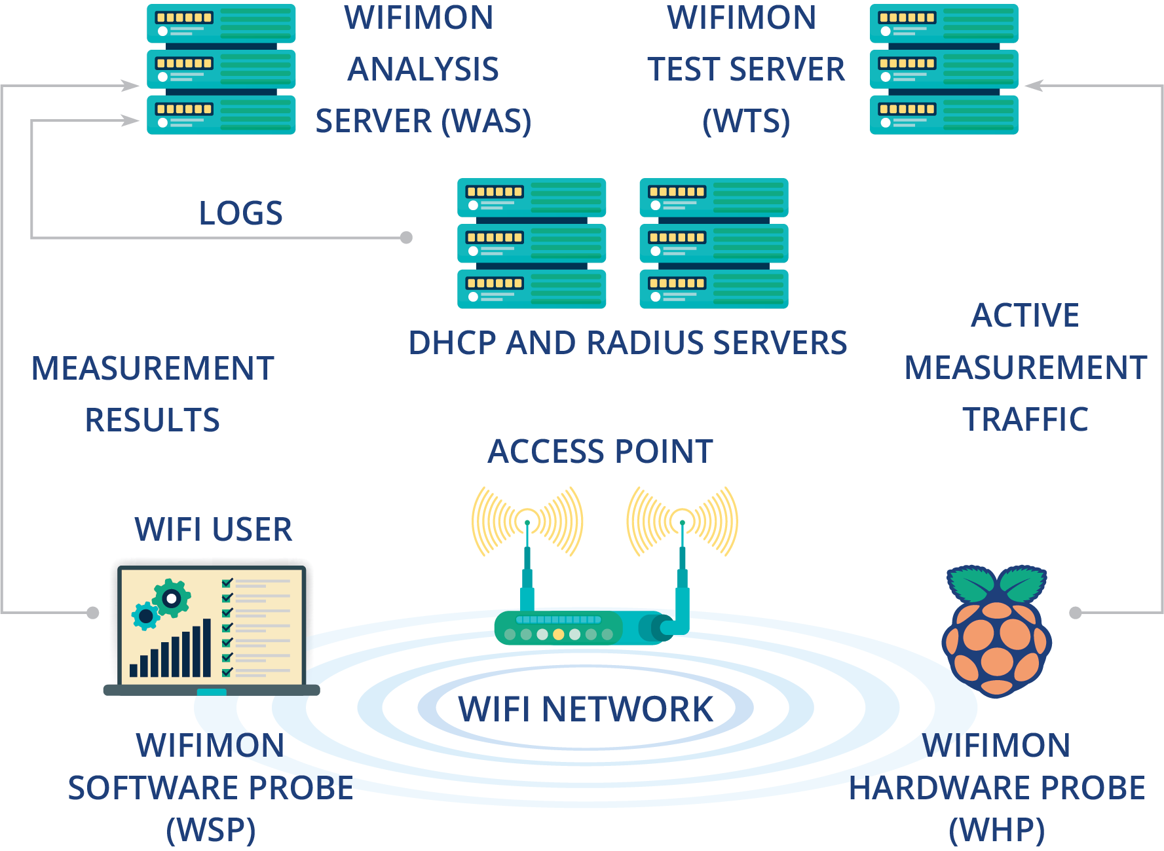
How it works
WiFiMon relies on two monitoring data sources:
Crowdsourced measurements
Hardware probe measurements
Performance data collected from active measurements:
Calculated by end-devices (WSP's and WHP's)
Streamed to the WAS
Optionally correlated with RADIUS/DHCP logs for richer analysis
Visualized through various dashboards of the WAS;

Slide 4




Who is it for
NRENs
Campus Networks
Conference Venues

Slide 5
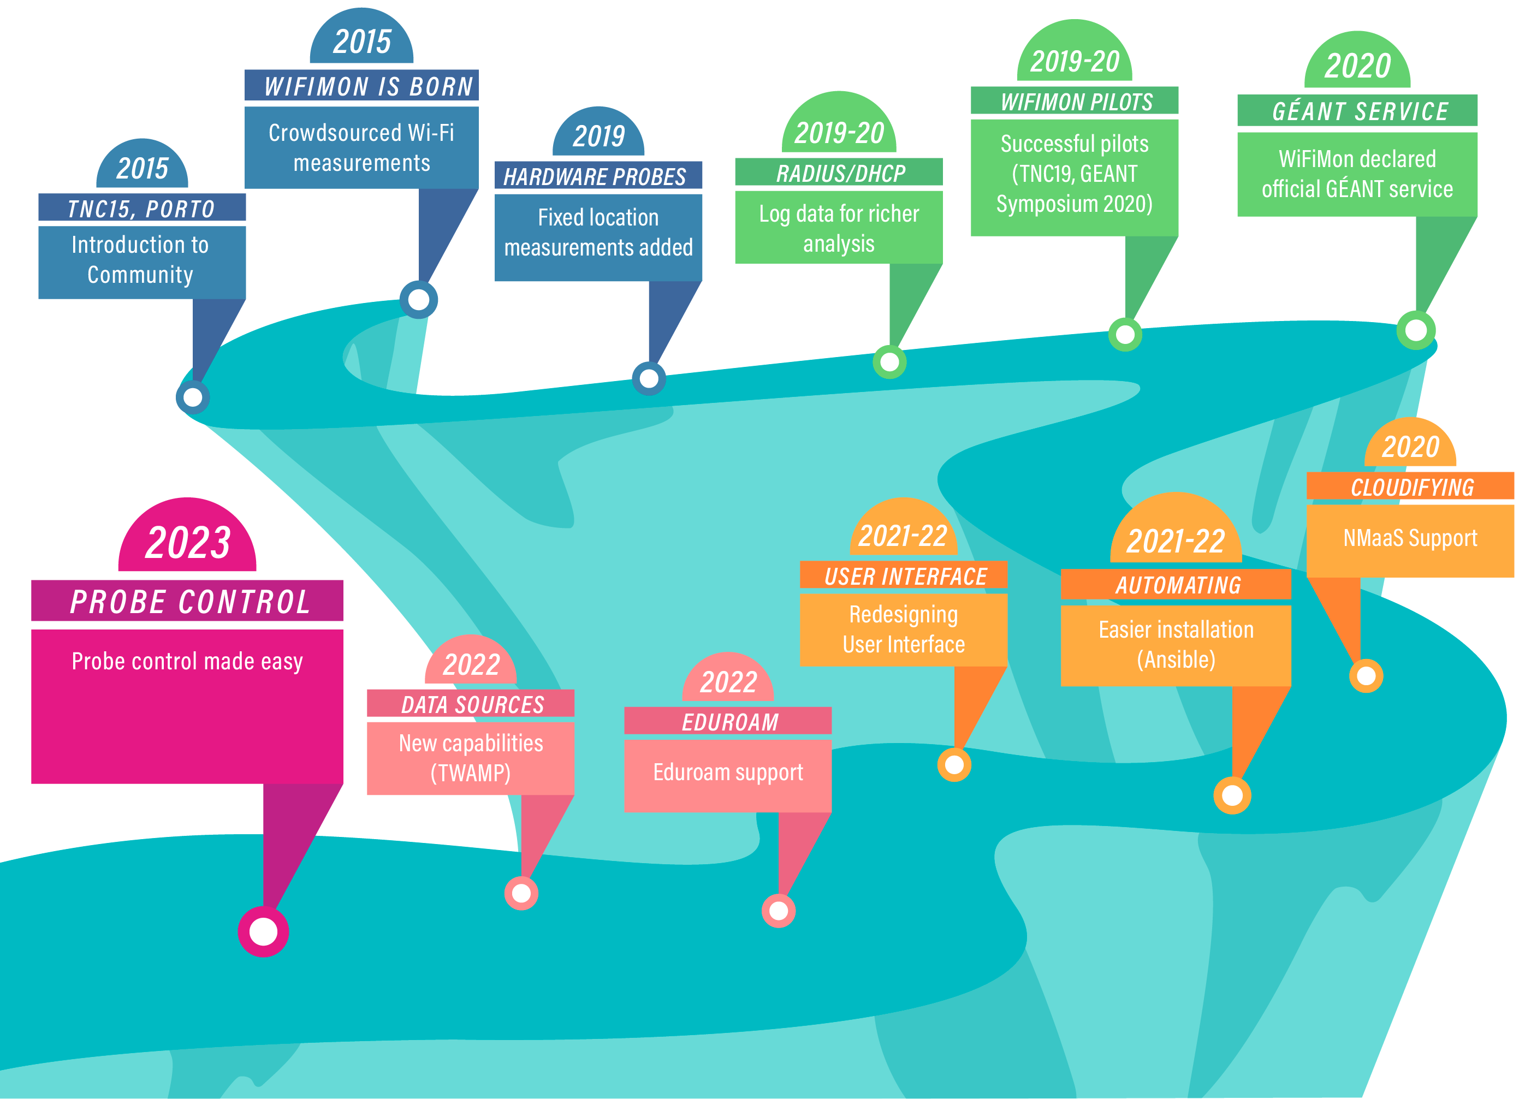

Slide 6
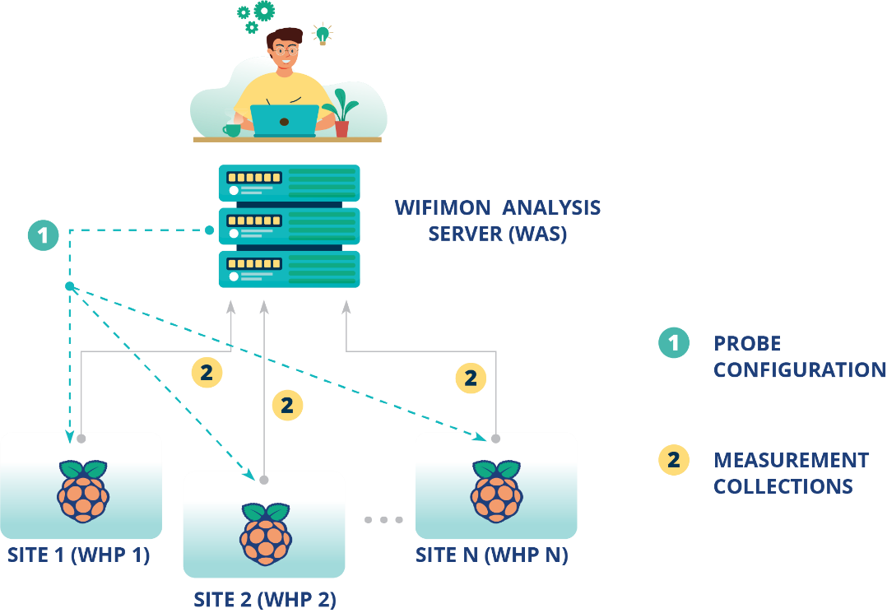
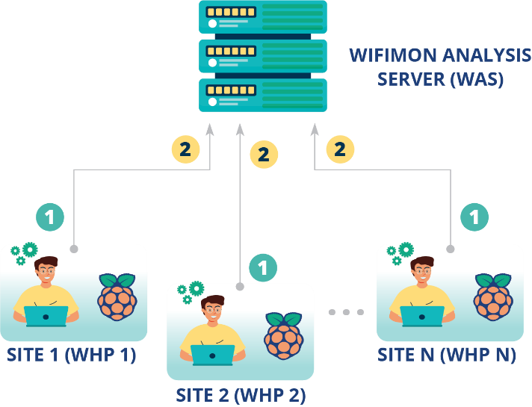
WHP Configuration & Control
Old approach
Administrator feedback demonstrated limitations:
In NAT networks
In public networks
Administrators edit config directly
Novel approach required!!!
Remote & user-friendly configuration of WHP’s from a central point (WAS)
Flexibility to control WHP’s behind NAT networks

Slide 7
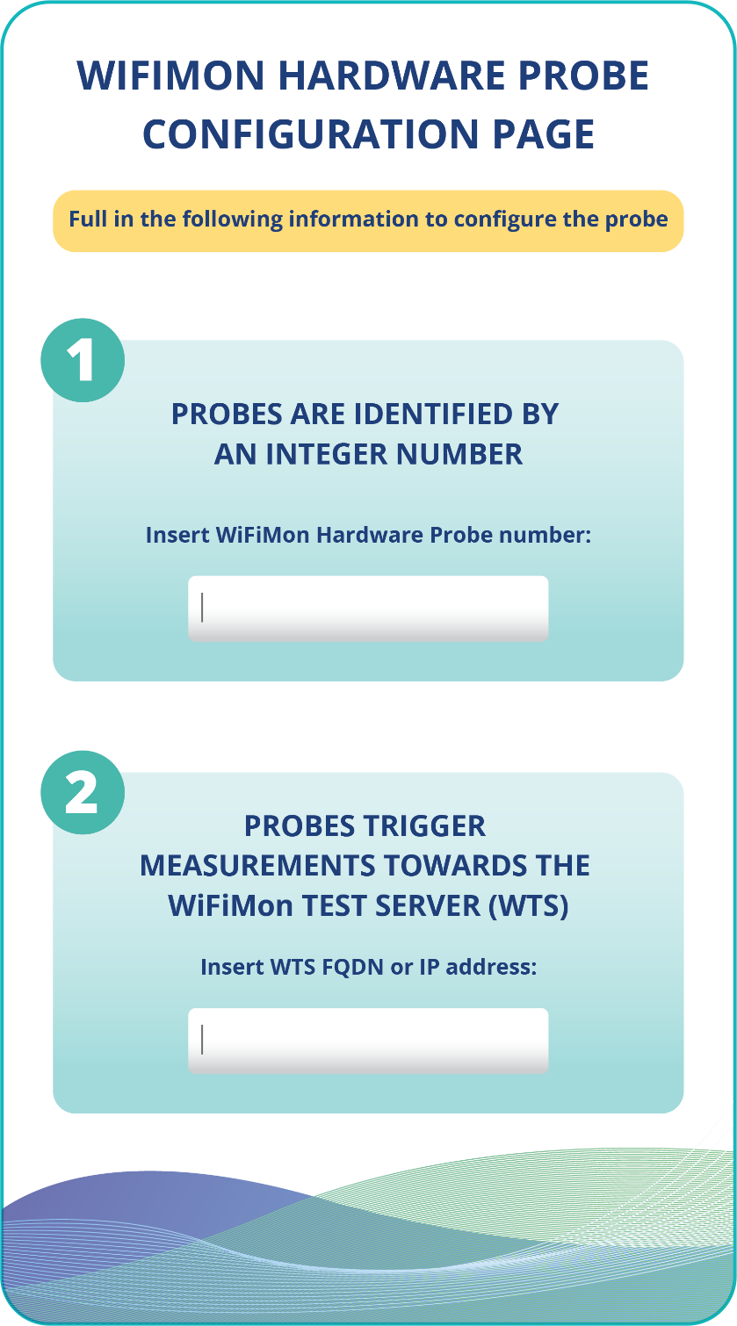
WHP Configuration Made easy
Administrators (re)configure WHP’s from the WiFiMon UI
Provided data:
Device ID
FQDN’s/IP addresses of WiFiMon components
Location information
Configuration files are generated based on Jinja2 templates

Slide 8
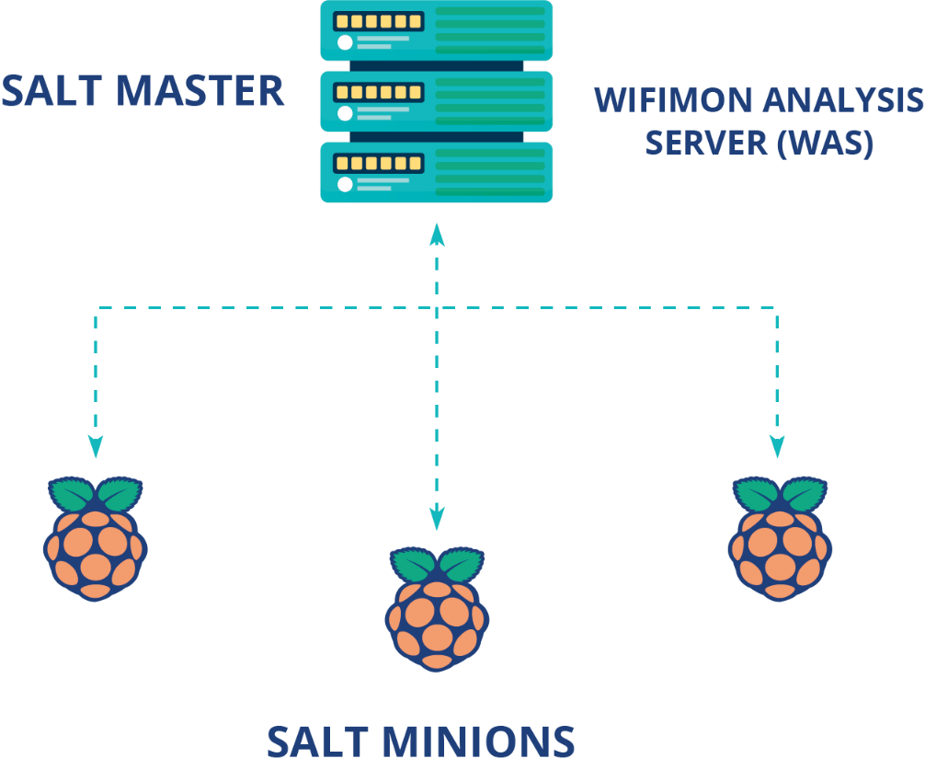
Remote WHP Configuration Made Possible
Solution based on the Salt infrastructure management tool
WiFiMon Analysis Server → Salt Master
WiFiMon Hardware Probes → Salt Minions

Slide 9
Remote WHP Configuration Made Possible
Salt establishes application layer communication: - WHP’s are remotely configured from the WAS
Remote reconfiguration possible even for WHP’s behind NAT
Public IP addresses are not required → IP space is not consumed
1
Salt includes a ZeroMQ message broker: Parallel configuration regardless of the WHP number
2
Configuration files generated from templates are transferred from the WAS to the respective probes
3

Slide 10


Future work
Automation of probe installation
Machine learning for performance prediction
More visualization options

Slide 11
Thank You

